Slide 1
Ultra Fine-Grained Run-Time Power Gating of On-Chip Routers for CMPS
Hiroki Matsutani, Hiroshi Nakamura The University of Tokyo Komaba Michihiro Koibuchi National Institute of Informatics Hitotsubashi
Daisuke Ikebuchi, Hideharu Amano Keio University Hiyoshi
Kimiyoshi Usami Shibaura Institute of Technology Toyosu

Slide 2
Movation
The router components which are just transferring a packet are activated, the leakage power of the on-chip network can be reduced to the near-optimal level
Certain amount of wakeup latency is required to activate the sleeping components, and the application performance will be degraded.

Slide 3
Power Gating Techniques
Coarse-Grained Power Gating:
Surrounded by GND
Power switches between GND and blocks or VDD and blocks
IP or module level
=> Straightfoward and easy control but imposes a microsecond order wakeup latency.

Slide 4
Power Gating Techniques
Fine-Grained Power Gating:
Standard cells level
Each cell has VGND port
All cells in domain share the same VGND line
=> Flexibility and short wakeup latency

Slide 5
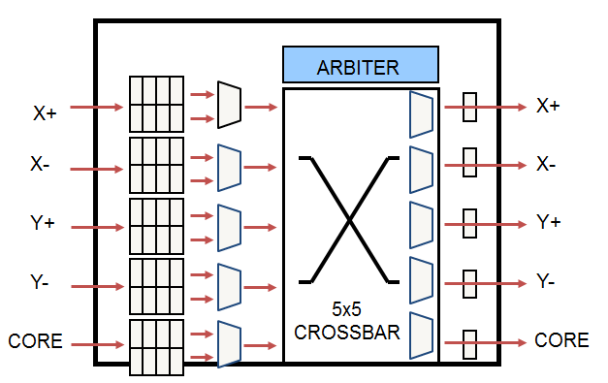
Ultra Fine-Grained Power Gating Router
Router is divided into many Micro-power-domains
Input VC buffers, Output latches
Crossbar MUXes, VC MUXes
Each power domain is activated only when it is “really” used

Slide 6
Wakeup Control Methods
Naive method
Three cycles router and three pipline stage (RC, VSA, ST)
VC buffer: Activation of input in router i when the packet router(i-1) completes VA and SA operations
VCMUX: Activation of VCMUX router i when the packet router(i-1) completes SA operations, VCMUX is shared by all VC
CBMUX: : Activation of CBMUX router i when the packet router(i-1) completes SA operations
Output latch: Activation all output latch router i, When the packet router(i-1) completes SA operations
=> Increases the communication latency and degrades the application performance.

Slide 7
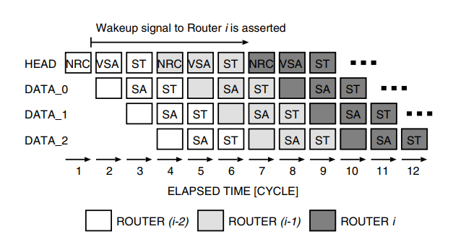
Wakeup Control Methods
Look-ahead method:
Look-ahead routing is used
Wakeup procedure starts 4-cycle in advance
Wakeup signals span 2-hop
Cannot wakeup the 1-hop router in advance

Slide 8
Wakeup Control Methods
Look-Ahead with Ever-On Method
VC buffers connected from CPU are always active
No wait for the first-hop
But, they consume leakage
=> Ever-on domain is only 4.7%; Minimum leakage power overhead

Slide 9
Wakeup Control Methods
Look-Ahead with Active Buffer Window (ABW) Method
A part of the buffer is always activated
Active buffer window shifts when it receives/sends flit
Short packets (less than window size) → No wait
ARBITER
X+
Window size = 3
X-
Y+
Y+
Y-
5x5 CROSSBAR
Read
CORE
Write

Slide 10
Thank you for your attention

